Slide 1
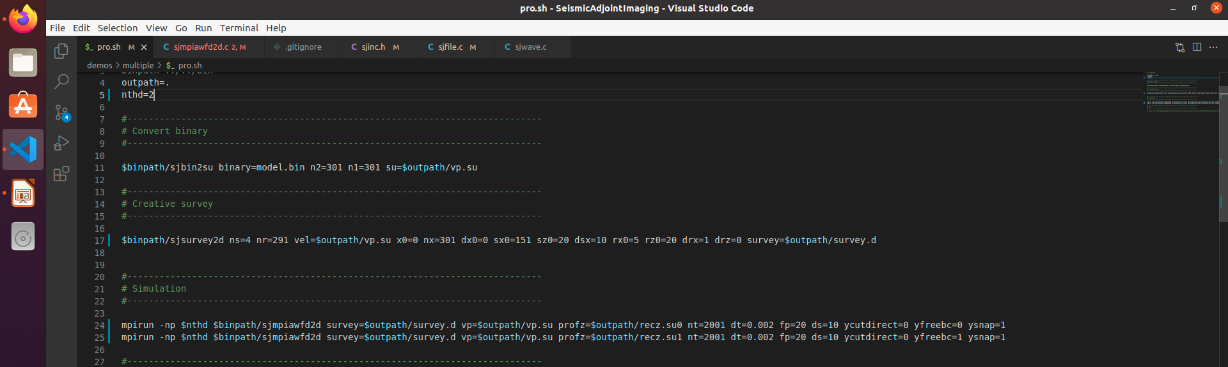
FREE SURFACE & MULTIPLES
DEMOS: ${ROOT}/demos/multiple
Cut direct wave?
Use free surface?
Use free surface?
Output snap?

Slide 2
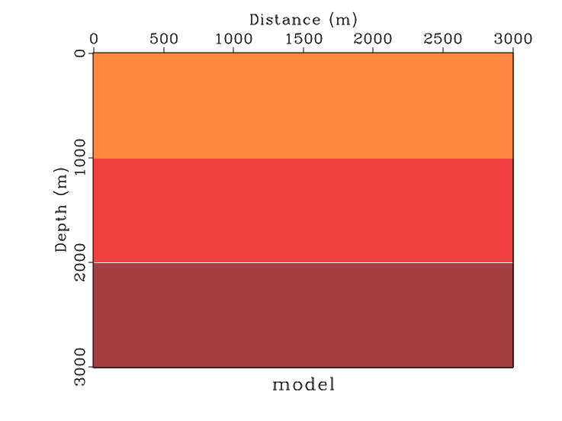
Example
Source: sx=1510, sz=200
sfsuread < vp.su endian=0 | sfput d1=10 d2=10 label1="Depth" label2="Distance" unit1="m" unit2="m" title="model" | sfgrey color=j > model.vpl
1400m/s, 1010m
2000m/s, 1000m
2500m/s, 1000m

Slide 3
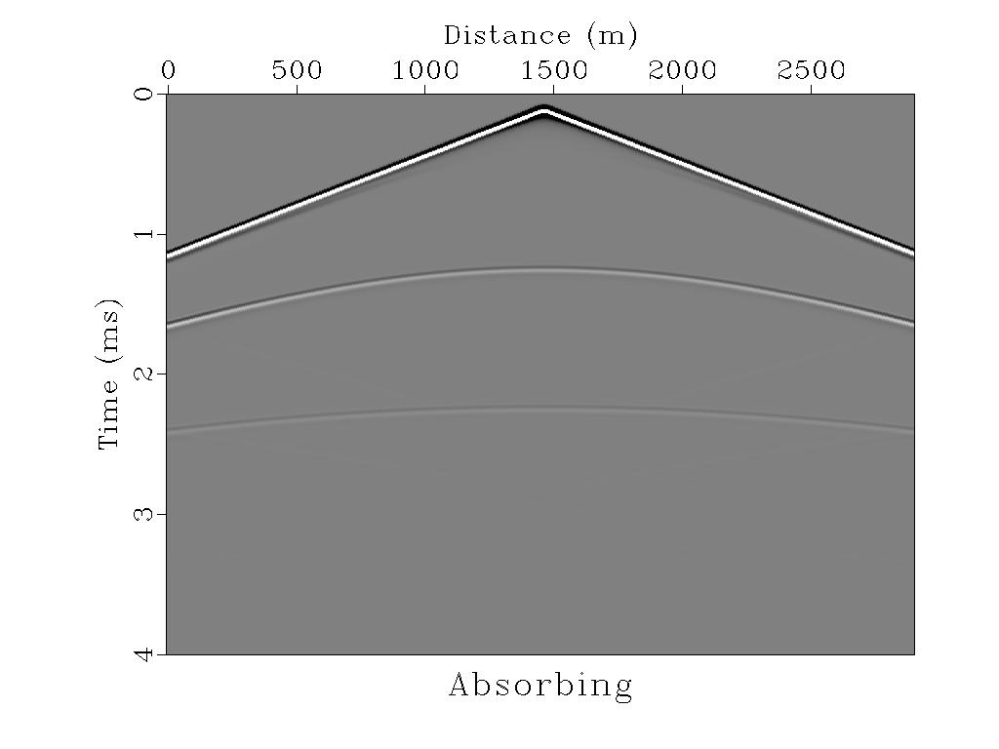
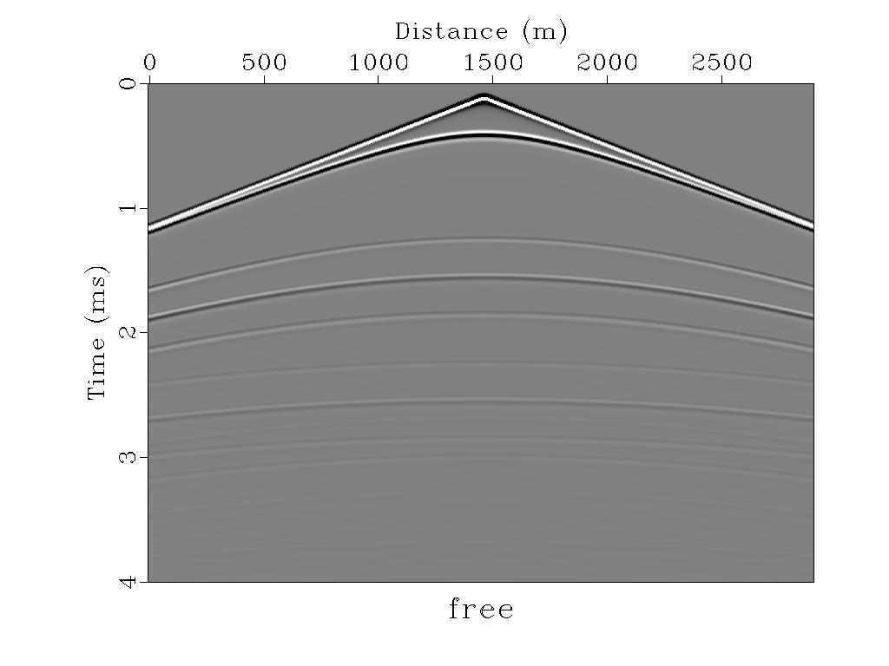
Example
Ghost
Direct wave
Normal
reflective
wave
Multiples

Slide 4
Example

